Slide 1
SS ZG653 (RL 17): Software Architecture Architecture of Next Gen Systems- Introduction to Cloud Computing
Instructor: Prof. Santonu Sarkar
March 31, 2015

Slide 2
Cloud Computing Paradigm
17.1

Slide 3
Characteristics of Cloud Computing
According to
National Institute of Standard & Technology

Slide 4
Service Oriented Software- Characteristics
Cloud Computing
Next Generation of Service

Slide 5
Four Key Infrastructure Components
Infrastructure Sharing
Provisioning of right sized infrastructure on-demand
Customers and providers form a larger ecosystem
Emergence of social network
Customers decide the feature
Virtualized Infrastructure
Social
Mobile
Analytics
Prolific adoption of mobile devices
Increase in mobile compute power
Next gen services will mobile device for service consumption
Massive data
From infrastructure
From social ecosystem
Next gen service will process and analyze this data for its own evolution

Slide 6
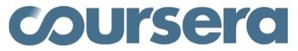




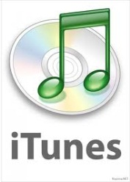



Examples
170 million Gmail users. Two major failures in Dec 2012 when Gmail upgraded its attachment capability to 10GB.
In 2012, > 200 courses, 33 universities, 1.9M students accessing video/audio lectures and presentation
Sep 2012- effected by DDOS attack
100M users, 100 PB
All of their user files were publicly accessible for 4 hrs due to authentication fault
185,000 applications on Force.com
6M Txn/day
1B active users, 500M uses mobile devices
500M active users, handles 1.6B queries per day
1B Txn/day.
They need to detect credit card fraud within 5ms.
8 petabytes/yr, 20hrs of new video/min

Slide 7
Data Deluge- structured, unstructured text, audio, and video
(http://www.emc.com/collateral/analyst-reports/diverse-exploding-digital-universe.pdf)
(http://hmi.ucsd.edu/pdf/HMI_2009_ConsumerReport_Dec9_2009.pdf),
(http://www2.sims.berkeley.edu/research/projects/how-much-info-2003/printable_report.pdf)
http://www.mckinsey.com/mgi/publications/big_data/index.asp
http://www.reuters.com/article/2011/07/19/idUS319973276120110719

Slide 8
Traditional versus Cloud Computing (Layered Rubric)
Client (presentation and devices)
Client (presentation and devices)
Software As a Service
Application
Service
Application
Platform As a Service
Application Framework, Middleware
Database
Service
Application Framework, Middleware, Database
Process
Computing Infrastructure (HW/SW)
Infrastructure As a Service
Process
OS
OS
Virtual Hardware
Virtual Hardware
Physical Hardware
Physical Hardware

Slide 9
Cloud Computing - Examples
Mobile- Andriod, iPhone, Windows Mobile
OS- gOS
Thin client- Zonbu, gOS based applications
Software As a Service
Identity : OAuth, OpenID
Integration : Amazon Simple Queue
Payments :Amazon Flexi Pay, PayPal
Mapping : Google Maps
Search :Google Custom Search, Yahoo! BOSS
Human: Mechanical Turk
Peer-peer : Skype, Bittorent
Web app : Facebook
SaaS: Google Apps, SAP, Salesforce
Microsoft Online service
Platform As a Service
Database :Amazon SimpleDB, Google BigTable
Network : MobileMe iDisk, CloudNAS
Synch : MobileMe push
App Framework: Google App Engine, Ruby on Rails
.NET : Azure Services Platform
Proprietary : Force.com
Infrastructure As a Service
Full virtualization (GoGrid, Skytap)
Grid computing (Sun Grid, HP)
Management (RightScale, Elastra, HP)
Compute (Amazon Elastic Compute Cloud)

Slide 10
System Virtualization
Virtual Machine Monitor (VMM) - Hypervisor
Underlying software platform that provides virtualization support
Manages several VMs
Two main services
Page mapping
Scheduling
Virtual machine
A software that simulates a machine environment
Guest Operating System
An operating system and its applications running inside a VM
Ubuntu
Redhat
Windows
Application
Application
Application
Application
Application
Application
10

Slide 11
Hypervisor
According to [1], a VMM should have
Equivalence
Efficiency
Resource Control
Furthermore a VMM provides
mediation between VM and hardware
Strong isolation (performance, fault and security)
encapsulation of virtual machine
Failure and recovery (Reliability)
Check pointing (Reliability)
Live migration (Availability)
1. G. J. Popek and R. P. Goldberg, "Formal Requirements for Virtualizable Third generation Architectures," Communications of ACM, vol. 17, no. 7, 1974

Slide 12
Ideal VMM Scenario
Hardware needed by monitor
Ex: VMM must control real hardware interrupts
Access to hardware would allow VM to compromise isolation boundaries
Ex: access to MMU would allow VM to write any page
So…
During virtualization- Ring 0 is occupied by VMM.
OS goes to Ring 3, it can’t call privileged instructions- trap is generated!!
All sensitive instructions must always pass control to the VMM
All access to the virtual System ISA by the guest must be emulated by the VMM in software.
System state kept in memory.
System instructions are implemented as functions in the VMM
User pgm
privileged
sensitive
These privileged instructions do not change machine resources but access privileged resources (e.g., IN, OUT, Write TLB)
Instruction trap
Interpreter routine-1
Interpreter routine-2
Dispatcher
These privileged instructions aim to change machine resources (e.g., load relocation bound register)
Allocator
Interpreter routine-n

Slide 13
Virtualization Problem with x86
A processor or mode of a processor is strictly virtualizable if, when executed in a lesser privileged mode:
all privileged instruction execution attempt causes a trap
Rest of the instructions execute identically
So that.. guest OS runs in a deprivileged mode and all privileged instructions creates a trap into VMM
VMM emulates instructions against virtual state
But x86 architecture is not virtualizable
ISA includes privileged instructions like POPF that read or modify privileged state but don’t trap in user mode
Hence VMM won’t know that a VM calls POPF

Slide 14
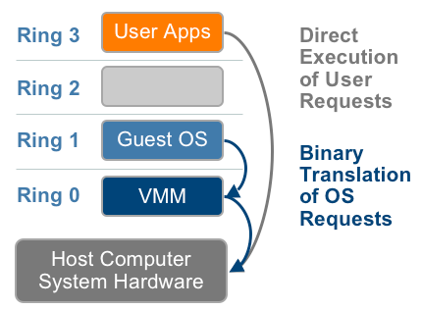
Full Virtualization
VMM fully abstracts CPU, memory, and IO
OS is de-privileged to Ring-1 which OS is not aware of. OS runs un-modified with regular device drivers
Binary instructions coming from OS is translated by the VMM using binary translation
Not every instruction is translated
Only the ones that are privileged
14

Slide 15
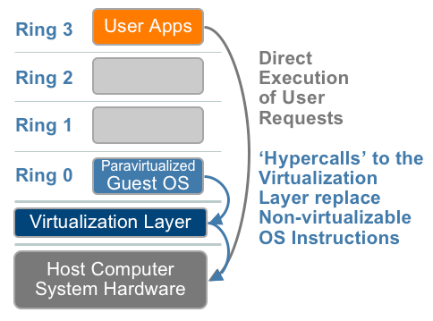
Solution 2 - Paravirtualization
Requires a modified guest OS to run with a hypervisor
Modified device drivers also are aware of hypervisor
Instead of privileged system calls to CPU, guest OS makes hyper calls directly to hypervisor – no need for BT
Challenge
Guest OS must be modified – difficult with proprietary OSes like Windows
15

Slide 16
More on Paravirtualization
Paravirtualization Exports Simpler Architecture
Modified Guest OS is aware of virtualization layer
Remove non-virtualizable parts of architecture
Avoid rediscovery of knowledge in hypervisor
Excellent performance and simple, but poor compatibility

Slide 17
Virtualization Basics- Memory Mgmt
Memory divided into pages- some are in physical memory and the rest are in disk (swap)
Page table maps consumer application address to machine address or disk location
Virtualized Environment
VM page table maps target address to an address within VM.
This is converted to physical address by Hypervisor page table

Slide 18
Memory Management
Guest OS sees flat “physical” address space.
Page tables within guest OS:
Translate from virtual to physical addresses.
Next level mapping is done by VMM
Physical addresses to machine addresses.
Application
Application
Machine RAM
Application
Application
Application
Application
Application
Application
Virtual RAM
Virtual RAM
Virtual RAM
Machine RAM

Slide 19
Virtualized Address Spaces
0
4GB
Current Guest Process
Guest OS
Virtual
Address Spaces
0
4GB
Virtual RAM
Virtual
Frame
Buffer
Virtual
Devices
Virtual
ROM
Physical
Address Spaces
0
4GB
RAM
Devices
Frame
Buffer
ROM
Host’s Machine
Address Space
Now, we need two-level translations:
Guest VA → Guest PA → Host MA
SLOW!! Each memory access needs to be translated in software
Notes:
In a traditional system there are typically 2 address spaces – the virtual address space (VAS) and the physical address space (PAS). The OS and user processes run in the VAS. The OS manages the mapping from VAS to PAS through the use of the Memory Management Unit (MMU) provided in the processor. The OS maintains a page table that maps each page in the current VAS to a page in the PAS. Typically the OS will maintain one page table per user level process.

Slide 20
Network- in a Nutshell
Recall every device, and a VM on a network can have its own IP address (32bit number for IPv4)
IP message has a header (source IP addr, destination IP addr) and the content
IPv6 has 128 bit header but it has source and destination IP
Gateway
An organization uses a gateway to manage incoming and outgoing traffic
Public IP: www.google.com (unique within internet)
Private IP: restricted within the organization (10.2.1.1)

Slide 21
Network Address Translation (NAT)
Outgoing message
Gateway records the private IP of the source, replace the header with its own public IP
Sends it to external network
Incoming message
Gateway intercepts, overwrites the destination IP (which is the gateway) with internal private IP
Sends it to internal network

Slide 22
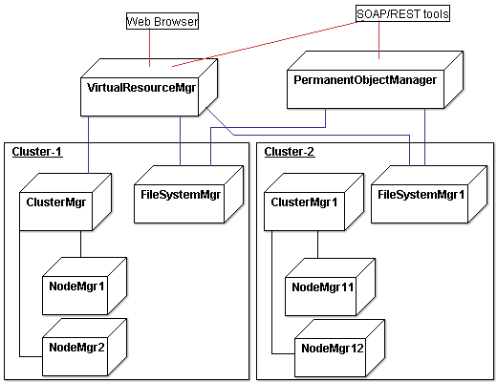
Infrastructure as a Service
Variety of clusters
A cluster manager manages node, and persistent object manager manages files
Cluster manager controls
execution of VMs on a node
Virtual networking between VMs and VM– external user
Node manager uses the hypervisor to manage VM execution, inspection, and termination

Slide 23
Networking in IaaS
Virtual Resource Manager acts as a Gateway
If a VM has a public IP address, IaaS automatically reallocates this to another VM if this VM fails
Auto Scaling
On demand, based on the workload, new VMs can be spawned

Slide 24
Data (Massive) and Storage
Forces against Traditional RDBMS
Billions of pages need to be collected and indexed. The data access is through simple indexes, sophisticated RDBMS indexing and optimization is not required
Data schema is not fixed
To get data from multiple table, join is required which is expensive when data is large
It is okay to have temporary inconsistency of data, but availability is a MUST

Slide 25
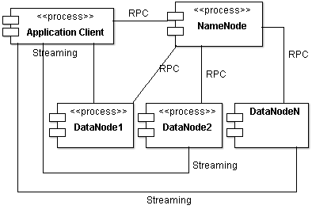
HDFS
One NameNode managing multiple DataNodes
Data stored in DataNodes in blocks of 64MB
Each block is replicated for Reliability
Component and Connector View

Slide 26
HBase
Hbase- key-value based database like Google’s BigTable
Trillions of data can be stored
Supports table but no schema, one column is key
A data-value is indexed by
Row value, column name, timestamp
Supported time based versioning
Web page crawling
Row value can be URL
Columns can be attributes of web-page
URL/timestamp can be the index

Slide 27
MongoDB
Stores data as object- containing all information about some concept
Without bothering whether a data field of one object is related to another object
Two objects can have all data fields common, some common or no commonality
Links in data items can serve as connection between object implicity…
Stored in binary JSON
A field may be indexed or not indexed. No concept of primary or secondary keys

Slide 28
Data Center and Cloud OS

Slide 29
Data Centers with Virtualization
Data centers must be virtualized to serve as cloud providers
There are open-source (Eucalyptus, OpenStack) and commercial (VMWare, Rackspace) virtual infrastructure (VI) managers and OSes.
Specially tailored for virtualizing data centers which often own a large number of servers in clusters
Create and manage VMs, aggregate them into virtual clusters
Dashboards for management and control

Slide 30
Amazon EC2
Amazon’s Elastic Compute Cloud (EC2) is a good example of a web service that provides elastic computing power in a cloud. EC2 permits customers to create VMs and to manage user accounts over the time of their use.

Slide 31
Various Cloud Platforms
OS, License | Resources being virtualized | Client API | Hypervisor | Public Cloud Interface | Features
Nimbus Linux, Apache v2 | VM creation, virtual cluster, www .nimbusproject.org/ | EC2 WS, WSRF, CLI | Xen, KVM | EC2 | Network virtualization
Eucalyptus Linux, BSD | Virtual networking www .eucalyptus.com/ | EC2 WS, CLI | Xen, KVM | EC2 | Network virtualization
OpenNebula Linux, Apache v2 | Management of VM, host, virtual network, and scheduling tools, www.opennebula.org/ | XML-RPC, CLI, Java | Xen, KVM | EC2 | Network virtualization
vSphere 4 Linux, Windows, proprietary | Virtualizing OS for data centers www .vmware.com/ products/vsphere/ | CLI, GUI, Portal, WS | VMWare ESXi | VMWare vCloud | Network virtualization, storage, HA, DRM, Live migration
Openstack, Linux, Apache v2 | VM creation, storage virtualization, key management | CLI, WS | KVM-QEMU, Xen, VMWare | EC2 | Network, storage, Live migration

Slide 32
Eucalyptus
CM
Public network
Cluster A
Cluster B
GM
GM
Interact with EC2.
Provide a storage API to emulate the Amazon S3 API for storing user data and VM images.
Installed on Linux-based platforms
Private network
Private network
IM
IM
IM
IM
IM
IM
IM
IM
Instance Manager controls the execution, inspection, and terminating of VM instances
Group Manager gathers information about and schedules VM execution on specific instance managers, as well as manages virtual instance network.
Cloud Manager: entry-point into the cloud for users and administrators. It queries node managers for information about resources, makes scheduling decisions, and implements them by making requests to group managers.
The Eucalyptus Open-source Cloud-computing System- 9th IEEE/ACM CCGrid-2009

Slide 33


Openstack
Compute(Nova): manages resource allocation and lifecycle of VMs.
Network (Neutron): Provides network connectivity between interface devices. It provides API-driven network and helps users manage IP addresses for their VMs.
Storage: Swift- allows data to be stored and retrieved as objects. Cinder provides persistent block storage of data to VMs. Glance is the repository of all virtual disk images and uses Swift as a backend.
Identity Management: Keystone provides the authentication, authorization, and access control for all interaction between services
Dashboard (Horizon): Web user interface for OpenStack services.
Dashboard
Network
Compute
VM
image
Image group data
Load/store image
Object Storage
Block Storage
Identity

Slide 34
Openstack capabilities
Dashboard for monitoring and control
Assign physical resources like pCPU, RAM, storage to an image
Different image types and snapshots – Linux, Windows and AWS EC2 images
Different container types, e.g. Single container (OVF), components (AMI, ARI, AKI)
VM Lifecycle Management
Terminate instance. Reboot instance. Log actions in instance. Console interface for command line etc. Edit image description.
Create a snapshot of instance current state

Slide 35
Cloud Architecture

Slide 36
Private and Public Cloud
Characteristics | Public clouds | Private clouds
Technology leverage and ownership | Owned by service providers | Leverage existing IT infrastructure and personnel; owned by individual organization
Management of provisioned resources | Creating and managing VM instances within proprietary infrastructure; promote standardization, preserves capital investment, application flexibility | Client managed; achieve customization and offer higher efficiency
Workload distribution methods and loading policies | Handle workload without communication dependency; distribute data and VM resources; surge workload is off-loaded | Handle workload dynamically, but can better balance workloads; distribute data and VM resources
Security and data privacy enforcement | Publicly accessible through remote interface | Access is limited; provide pre-production testing and enforce data privacy and security policies
Example platforms | Google App Engine, Amazon AWS, Microsoft Azure | IBM RC2

Slide 37
Infrastructure as a Service- Most Basic Cloud Service
Amazon EC2, Rackspace etc. offer computers, as physical or more often as VMs, and other resources.
VMs run on a hypervisor, such as Xen or KVM.
You buy a VM of a certain capacity, often with a pre-installed OS and then install your own application software
Login via ssh or through browser
Amazon/Rackspace bills you as per the number of hours the VM is running
to reflect the amount of resources allocated and consumed.
Amazon CloudFormation (and underlying services such as Amazon EC2), Rackspace Cloud, Terremark, and Google Compute Engine

Slide 38
Platform as a Service & Software as a Service
Microsoft Azure, Force.com etc. deliver a computing platform typically including
OS, programming language execution environment, database, and web server, email service etc.
You develop and run your software on this platform
No cost and complexity of buying and managing the underlying hardware and software layers.
Amazon Elastic Beanstalk, Cloud Foundry, Heroku, Force.com, EngineYard, Mendix, Google App Engine, Microsoft Azure and OrangeScape
Microsoft or Salesforce.com install and operate application software in the cloud
you access the software (Word, Excel, Salesforce Software) typically through browser based environment
Pricing model: Typically a monthly or yearly flat fee per user
Google Apps, innkeypos, Quickbooks Online, Limelight Video Platform, Salesforce.com, and Microsoft Office 365

Slide 39
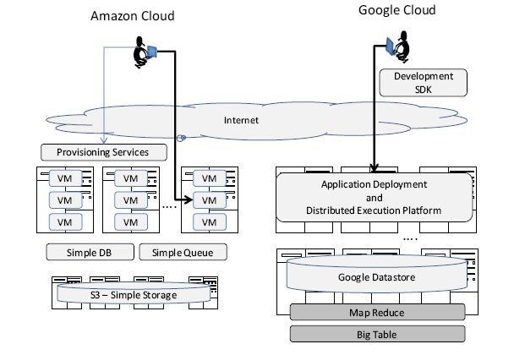
IAAS vs PAAS

Slide 40
Amazon Web Service (AWS) – Leader in IaaS
EC2 (Elastic compute cloud) allows
Rent VMs and add more on-demand
Can create, launch, and terminate server instances as needed, paying by the hour for active servers.
S3 (simple storage service) provides the object-oriented storage service for users.
EBS (Elastic block service) provides the block storage interface which can be used to support traditional applications.
Amazon DevPay is a simple to use online billing and account management service that makes it easy for businesses
MPI clusters uses hardware-assisted virtualization instead of para-virtualization and users are free to create a new AMIs
AWS import/export allows one to ship large volumes of data to and from EC2 by shipping physical discs.
Small-business companies can put their business on the Amazon cloud platform. Using AWS they can service a large number of internet users and make profits through those paid services

Slide 41
Amazon EC2
VM Access
Web service interfaces to launch instances with a variety of operating systems (bundled into AMIs)
Load a VM with custom application environment
Manage network’s access permissions
Scaling really fast
Obtain and boot new server instances
Increase or decrease capacity
On-Demand Instances
Pay-by-the hour
Start and stop as you wish
Reserved Instances
Pay-by-the-year
Reserved for you, can start-or-stop as needed
Spot Instances
Bid for unused EC2 capacity with a spot price SP
If market price < SP you get your instance
If market price > SP, instance automatically terminates

Slide 42
Amazon VM Lifecycle
Standard EC2 Instance (Once terminated, data is lost)
EBS-backed EC2 Instance (Data persists as long as EBS volume is Intact)
Amazon Elastic Block Store (EBS) offers persistent storage for Amazon EC2 instances
Persists the image file independently from the life of an instance
You can create point-in-time consistent snapshots of your volumes
Can be used as the starting point for new Amazon EBS volumes
Can protect data for long term durability
Can be easily shared with co-workers and other AWS developers
Snapshots are stored in Amazon S3, and automatically replicated across multiple available zones
Cost (EBS volume)
Cost (instance-hr)
ec2-run-instances
ec2-reboot-instances
Pending
Running
ec2-terminate-instances
ec2-start-instances
ec2-stop-instances
Terminated
Shutting Down
Stopped
ec2-terminate-instances

Slide 43
Thank You

